Slide 1
D3 Tutorial

Slide 2
D3
D3 is a short for Data-Driven Documents
It is a JavaScript Library created by Mike Bostock available at: d3.js.org

Slide 3
HTML + CSS
What is HTML?
What is CSS?

Slide 4
JavaScript
D3 is a JavaScript library
What is javaScript?
JavaScript is used in billions of Web pages to add functionality, validate forms, communicate with the server, and much more.
JavaScript is the most popular scripting language on the internet, and works in all major browsers

Slide 5
JavaScript
Not Java!!
JavaScript was designed to add interactivity to HTML pages
JavaScript is a scripting language - a lightweight programming language.
JavaScript is usually embedded directly into HTML pages
JavaScript is an interpreted language (means that scripts execute without preliminary compilation)
Everyone can use JavaScript without purchasing a license

Slide 6
SVG
What is SVG?
Scalable Vector Graphics (SVG) is a graphics file format and Web development language based on XML. SVG enables Web developers and designers to create dynamically generated, high-quality graphics from real-time data with precise structural and visual control. It is an open standard.
Vectors
Vector graphics are created with paths having a start and end point, as well as points, curves and angles in between. Since Vector Graphics are not created out of pixels, they can be scaled up to larger or smaller sizes without losing image quality.

Slide 7
SVG
SVG images and their behaviors are defined in XML text files. The XML text can be included in an HTML document. This text means that images can be created and edited in a text editor. Also, since the DOM includes XML as part of the DOM specification, we can use the DOM Tree to access and update the structure, content and style of SVG Images.
SVG comes with a basic set of shape elements:
Rectangle
Circle
Ellipse
Line
Ploygon
Etc.

Slide 8
SVG
Rectangle Example & Code:
<svg width="50" height="50">
<rect x="0" y="0" width="50" height="50" fill="green" />
</svg>
Circle example and code:
<svg width="50" height="50">
<circle cx="25" cy="25" r="25" fill="purple" />
</svg>

Slide 9
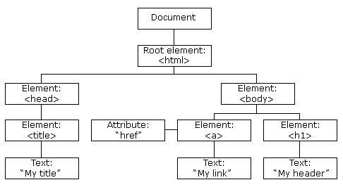
DOM
The HTML DOM defines a standard way for accessing and manipulating HTML documents.
The HTML DOM is a standard for how to get, change, add, or delete HTML elements.
The DOM presents an HTML document as a tree-structure.

Slide 10
Getting Started
Lets go over the basic concepts using the given tutorial
Next, are listed some important commands:

Slide 11
Select
Selections – selects an element/s
d3.select("body")
D3 looks at the document and selects the first descendant DOM element that contains the tag body.
Once an element is selected, D3.js allows you to apply operators to the element you have selected.
Notes:
https://www.dashingd3js.com/

Slide 12
Select
d3.select()
d3.select(״body״)
d3.selectAll(“p”).style(“color”, ”white”);

Slide 13
Append operator
d3.select("body").append("p");
The Append Operator appends a new element as the last child of the element in the current selection.
Since our current selection was d3.select("body"), the append operator added the "p" element last.

Slide 14
Adding an SVG element
d3.select("body").
append("svg")
.attr("width", 50)
.attr("height",50)
.append("circle")
.attr("cx", 25)
.attr("cy", 25)
.attr("r", 25)
.style("fill", "purple");

Slide 15
.attr (name, value)
Sets the attribute of a specified name with a specified value
.style (name, value)
sets the CSS style property for the given selection with the given specified value.

Slide 16
Binding data

Slide 17
Binding data
var dataset = [ 5, 10, 15, 20, 25 ];
var p = d3.select("body")
.selectAll ("p")
.data(dataset )
.enter()
.append("p")
.text("hello ");

Slide 18
.selectall
Selectall
Unlike the Select method (where the first element is selected), the SelectAll method selects all the elements that match the specific selector string.
What it is doing is selecting all of the <p> available on the page. Which in this case is none. So it returns an empty selection.

Slide 19
.data
.data(theData)
The data operator joins an array of data (which can be numbers, objects or other arrays) with the current selection.
each element of theData array of data is assigned to each element of the current selection. The first element 1 is assigned to the first <p> element, the second to the second, so on and so forth.
But wait! The basic page doesn't contain any <p> yet. What is it actually doing?

Slide 20
.enter
The D3.js Data Operator returns three virtual selections.
The three virtual selections are enter, update and exit.
The enter selection contains placeholders for any missing elements.
The update selection contains existing elements, bound to data.
Any remaining elements end up in the exit selection for removal.
Since our selection from
d3.select("body").selectAll("p")
Was empty the virtual enter selection now contains placeholders for our <p> elements

Slide 21
.enter
The D3.js Enter Method returns the virtual enter selection from the Data Operator. This method only works on the Data Operator
var p = d3.select("body").selectAll("p").data(theData).enter()
This will return a reference to the placeholder elements (nodes) for each data element that did not have a corresponding existing DOM Element.
Once we have this reference we can then operate on this selection.

Slide 22
When data is assigned to an element, it is stored in the property __data__.
you can see this using the console:
console.log(d3.select("body"));
var p = d3.select("body")
.selectAll("p")
.data(theData)
.enter()
.append("p")
.text("hello ");

Slide 23
Using data that is bound to DOM elements
Now instead of the last line, lets put:
.text( function (d) { return d; } );
The selection for the .text is five <p> elements.
If the value passed to the Text Operator is a function, then the function is evaluated for each element in order. And the functions result is used to set each element's text context.
in our case, this means, that instead of setting "Hello" as the text value, the function goes through each element, gets the __data__ property and returns it to the Text Operator, so that it can set that result as the text content for the element.

Slide 24
JavaScript Functions in D3.js Operators
We are passing a JavaScript function to the Text operator:
function (d) { return d; }
Using functions, you can write anything you want using JavaScript to manipulate the data.
the variable d is available for use in the anonymous function. This variable is provided to us by D3.js and it refers to the current __data__ attribute for the specific element being processed.

Slide 25
JavaScript Functions in D3.js Operators
The are two other variables provided to us by D3.js - this and i.
this refers to the current DOM element being evaluated.
i refers to the index of the current HTML element being evaluated in the selected elements selection. (Note - i starts at 0).

Slide 26
Using SVG

Slide 27
SVG
Rectangle Example & Code:
<svg width="50" height="50">
<rect x="0" y="0" width="50" height="50" fill="green" />
</svg>
Circle example and code:
<svg width="50" height="50">
<circle cx="25" cy="25" r="25" fill="purple" />
</svg>

Slide 28
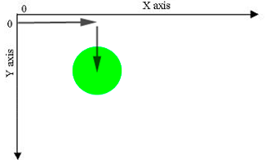
SVG coordinate space
<svg width="500" height="50"> </svg>
>svg width="500" height="50">
</svg>
var svgContainer = d3.select("body").
append("svg")
.attr("width", 200)
.attr("height", 200)
.style("border", "1px solid black");

Slide 29
Creating SVG elements based on data
<svg width="50" height="50">
<circle cx="25" cy="25" r="25" fill="purple" />
</svg>
Is the same as doing this:
var svgContainer = d3.select("body").append("svg")
.attr("width", 200)
.attr("height", 200);
var circleSelection = svgContainer.append("circle")
.attr("cx", 25)
.attr("cy", 25)
.attr("r", 25)
.style("fill", "purple");

Slide 30
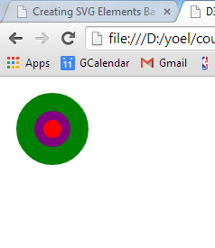
Creating SVG elements based on data
var circleRadii = [40, 20, 10];
var circles = svgContainer.selectAll("circle")
.data(circleRadii)
.enter()
.append("circle");
var circleAttributes = circles.attr("cx", 50)
.attr("cy", 50)
.attr("r", function (d) { return d; })
.style("fill", function(d) {
var returnColor;
if (d === 40) { returnColor = "green"; 19 } else if (d === 20) { returnColor = "purple";}
else if (d === 10) { returnColor = "red"; }
return returnColor;
});

Slide 31
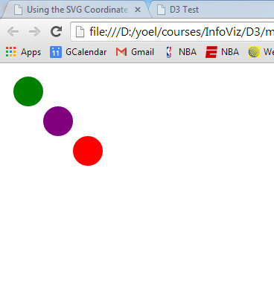
var circleRadii = [110, 70, 30];
var circleAttributes = circles
.attr("cx", function (d) { return d; })
.attr("cy", function (d) { return d; })
.attr("r", 20 )
.style("fill", function(d) {
var returnColor;
if (d === 30) { returnColor = "green";
} else if (d === 70) { returnColor = "purple";
} else if (d === 110) { returnColor = "red"; }
return returnColor;
});

Slide 32
Variables
console.log(numbers[i])
console.log(numbers[i])
javaScript is a loosely typed language. No need to specify the type of the variable.
var value = 100;
value = 99.99
value = false
value = “this is a text”
value = {1,2,3,4,5}
console.log (value[2])

Slide 33
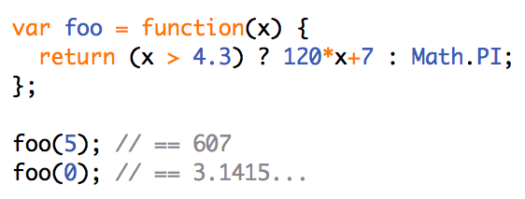
Functional Variables
Notes:
Variables can be functions

Slide 34
Animation
.on(“.mouseover”, function () {d3.select.(this).style(“fill”,”blue”)
.transition().delay(100).duration(1000)
See animation example:
http://christopheviau.com/d3_tutorial/

Slide 35
Objects
var fruits = [ { kind: "grape",
color: "red",
quantity: 12,
tasty: true },
{ kind: "kiwi",
color: "brown",
quantity: 98,
tasty: true },
{ kind: "banana",
color: "yellow",
quantity: 0,
tasty: true } ];
Fruit[1].kind – returns “kiwi”
var fruit = { kind: "grape",
color: "red",
quantity: 12,
tasty: true };
fruit.kind – returns grape

Slide 36
Data structures in D3

Slide 37
JSON
JavaScript Object Notation
Open standard file format that uses standard text to store and transmit data.
Very common and is often used instead of XML or CSV
Independent of JavaScript
Almost all programming language include support for parsing and using JSON

Slide 38
JSON
{ "firstName": "John",
"lastName": "Smith",
"isAlive": true,
"age": 27,
"address": { "streetAddress": "21 2nd Street",
"city": "New York",
"state": "NY",
"postalCode": "10021-3100" }, "phoneNumbers": [ { "type": "home",
"number": "212 555-1234" },
{ "type": "office",
"number": "646 555-4567" } ], "children": [],
"spouse": null }

Slide 39
JSON support
D3 selections are arrays
var jsonCircles = [
{ "x_axis": 30, "y_axis": 30, "radius": 20, "color" : "green" },
{ "x_axis": 70, "y_axis": 70, "radius": 20, "color" : "purple"},
{ "x_axis": 110, "y_axis": 100, "radius": 20, "color" : "red"}];
var svgContainer = d3.select("body").append("svg")
.attr("width", 200)
.attr("height", 200);
var circles = svgContainer.selectAll("circle")
.data(jsonCircles)
.enter()
.append("circle");
var circleAttributes = circles
.attr("cx", function (d) { return d.x_axis; })
.attr("cy", function (d) { return d.y_axis; })
.attr("r", function (d) { return d.radius; })
.style("fill", function(d) { return d.color; });

Slide 40
Reading from files
D3.csv (“file name”, callback(data)) – to directly open a csv file ignoring the header. You can read more about it here: https://www.tutorialsteacher.com/d3js/loading-data-from-file-in-d3js
D3.csv.parseRows – parses a csv string including the header
D3.csv.parse – parses a csv string ignoring the header.
D3.json – directly open a json file

Slide 41
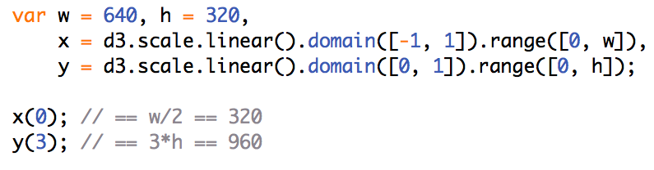
Scale
Scales are functions that map from an input domain to an output range.
Notes:
This is very common in D3 examples

Slide 42
d3.scale.linear.
domain(...)
.range(...)
var tempScale = d3.scale.linear()
.domain([0, 10])
.range( [0, 100]);
tempScale.(5); // returns 50
tempScale.domain([0, 100]);
tempScale(5); // returns 5
https://alignedleft.com/tutorials/d3/scales

Slide 43
Related functions
nice() — This tells the scale to take whatever input domain that you gave to range() and expand both ends to the nearest round value. “For example, for a domain of [0.20147987687960267, 0.996679553296417], the nice domain is [0.2, 1].” This is useful for normal people, who find it hard to read numbers like 0.20147987687960267.
rangeRound() — Use rangeRound() in place of range() and all values output by the scale will be rounded to the nearest whole number. This is useful if you want shapes to have exact pixel values, to avoid the fuzzy edges that may arise with antialiasing.
clamp() — By default, a linear scale can return values outside of the specified range. For example, if given a value outside of its expected input domain, a scale will return a number also outside of the output range. Calling .clamp(true) on a scale, however, forces all output values to be within the specified range. Meaning, excessive values will be rounded to the range’s low or high value (whichever is nearest).

Slide 44
Creating axes
Var xAxis = d3.svg.axis() // returns a function
.scale(xScale)
.orient(bottom) // where the labels should appear relevant to the axis
.ticks(5) // num of axis ticks
svg.append(“g”)
.call(xAxis)

Slide 45
svg.append(“g”)
.attr(“class”, “axis”)
.call(xAxis)
.axis path,
.axis line {
fill: none;
stroke: black;
shape-rendering: crispEdges;
}
.axis text {
font-family: sans-serif;
font-size: 11px; }

